Slide 1
TVC Olympic Games 2012 London - Best Job (P&G)
An analysis by

Slide 2


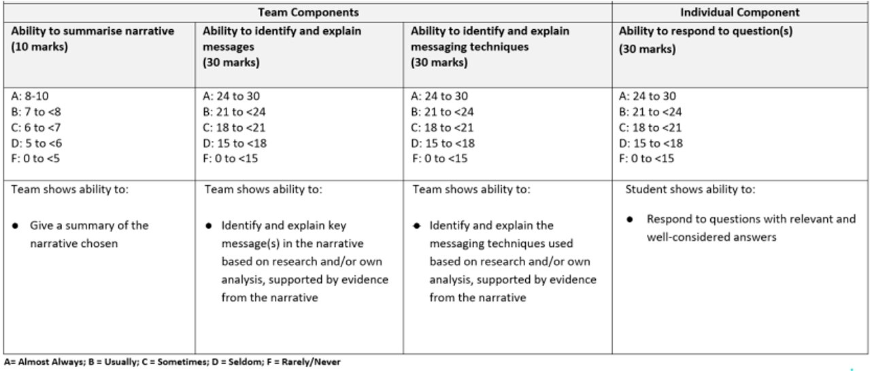
Roadmap
Background Introduction
Video
Narrative Summary
Intended Messages
Messaging techniques
QNA

Slide 3
Background Info
Procter & Gamble (P&G)
London 2012 Olympic
American multinational consumer goods
300,000 views on YouTube Reuploads
Notes:
This Olympic television commercial was from Procter & Gamble (P&G), and the corporation released multiple campaign ads during the Olympics to “Thank moms” but the one we choose was the London 2012.
P&G is an American multinational consumer goods corporation that sells cleaning products, health care and hygiene products.
The commercial was popular, even the reuploads got 300 thousand views on YouTube, plus they managed to reach around 16 million Olympic fans.

Slide 4


Slide 5
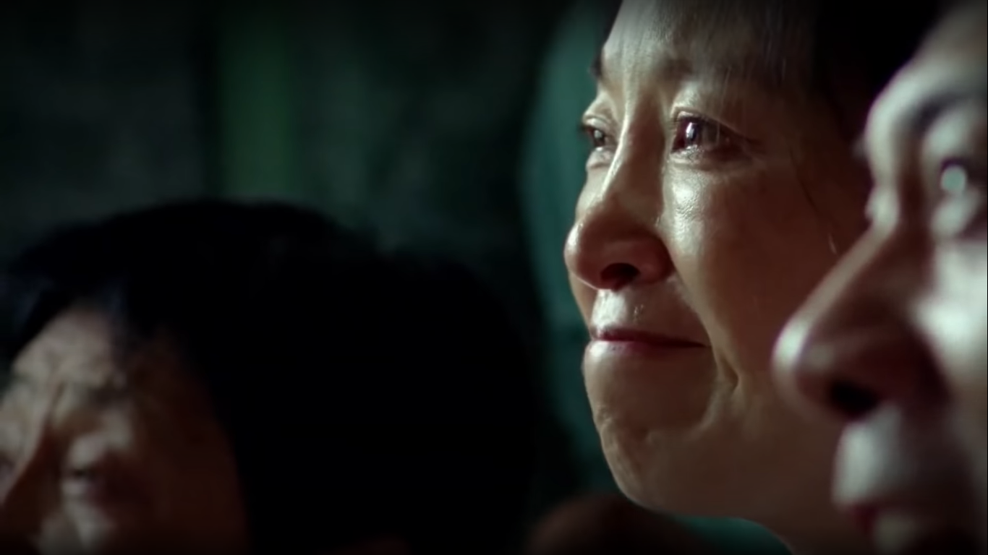
Narrative​ Summary​

Slide 6
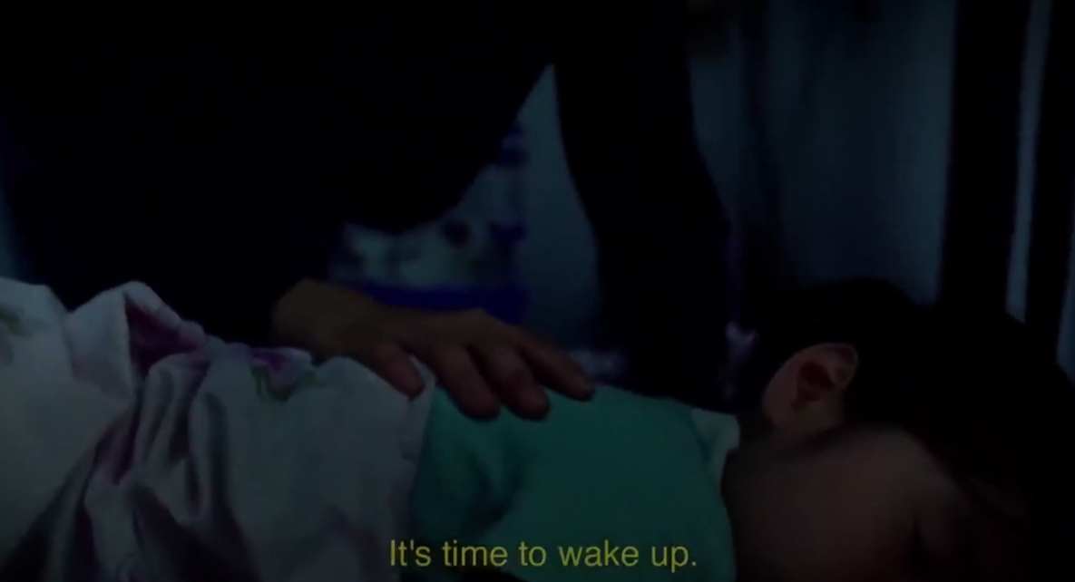
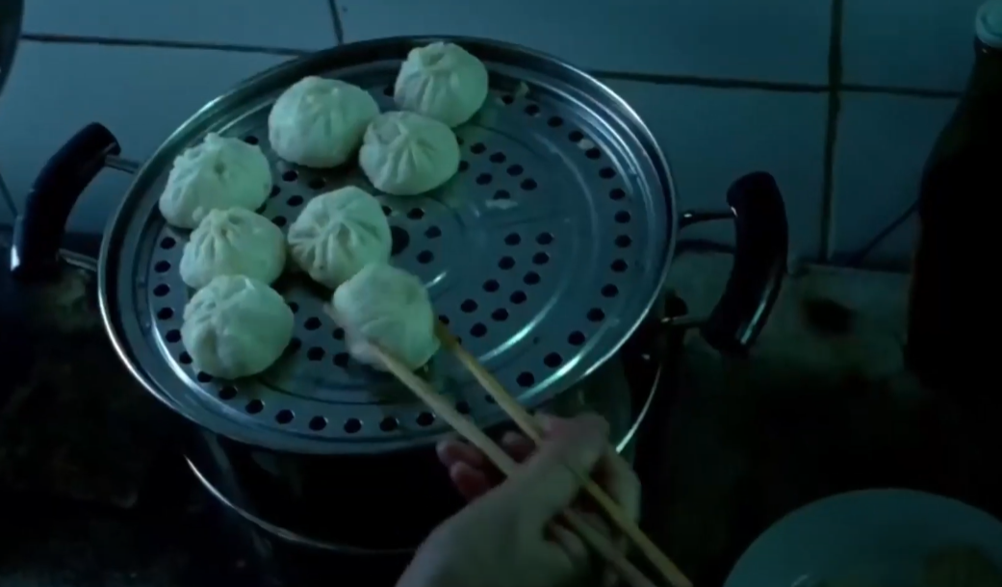
Preparing breakfast
Waking up their child
Notes:
This 2 minute plus commercial, it starts off with the mothers waking up their children and preparing them for the day,
It then shows us the mothers spending time watching over their child while they are practicing and alternating to them doing chores.
The video then time skips to where they are Olympic Athletes and show each athletes succeeding and their mothers crying tears of joy from their success.
The last part which is the message from the company saying that being a mom is the "The hardest job in the world and therefore is the best job in the world" and ends of by with proclaiming themselves as proud sponsor of moms.

Slide 7

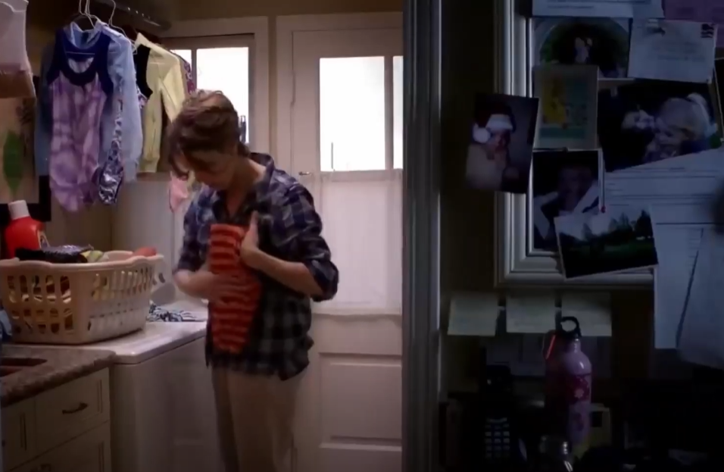
Doing laundry
Watching over their child
Notes:
This 2 minute plus commercial, it starts off with the mothers waking up their children and preparing them for the day,
It then shows us the mothers spending time watching over their child while they are practicing and alternating to them doing chores.
The video then time skips to where they are Olympic Athletes and show each athletes succeeding and their mothers crying tears of joy from their success.
The last part which is the message from the company saying that being a mom is the "The hardest job in the world and therefore is the best job in the world" and ends of by with proclaiming themselves as proud sponsor of moms.

Slide 8


Tears of joy
Olympic Athletes
Notes:
This 2 minute plus commercial, it starts off with the mothers waking up their children and preparing them for the day,
It then shows us the mothers spending time watching over their child while they are practicing and alternating to them doing chores.
The video then time skips to where they are Olympic Athletes and show each athletes succeeding and their mothers crying tears of joy from their success.
The last part which is the message from the company saying that being a mom is the "The hardest job in the world and therefore is the best job in the world" and ends of by with proclaiming themselves as proud sponsor of moms.

Slide 9


Notes:
This 2 minute plus commercial, it starts off with the mothers waking up their children and preparing them for the day,
It then shows us the mothers spending time watching over their child while they are practicing and alternating to them doing chores.
The video then time skips to where they are Olympic Athletes and show each athletes succeeding and their mothers crying tears of joy from their success.
The last part which is the message from the company saying that being a mom is the "The hardest job in the world and therefore is the best job in the world" and ends of by with proclaiming themselves as proud sponsor of moms.

Slide 10

Intended Messages

Slide 11
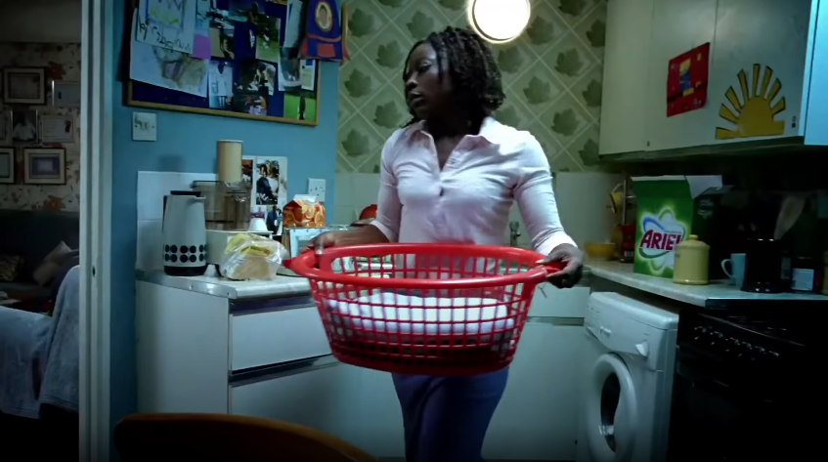
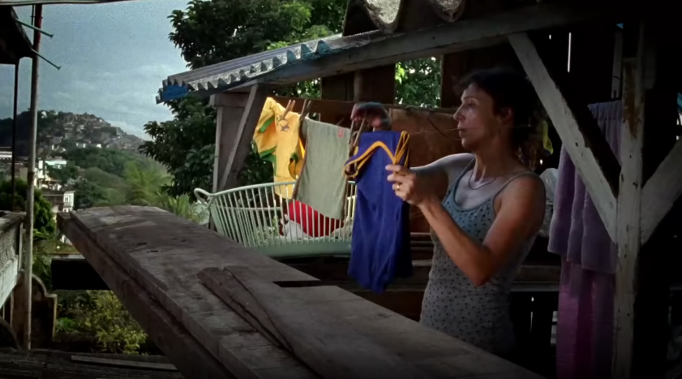
Intended Message 1
To show how we rely on our mothers
Notes:
Who comes to your mind when you are hurt, happy or feel helpless as a kid? It's probably your mom, the video only show them doing laundry but in reality it's more than just laundry.

Slide 12

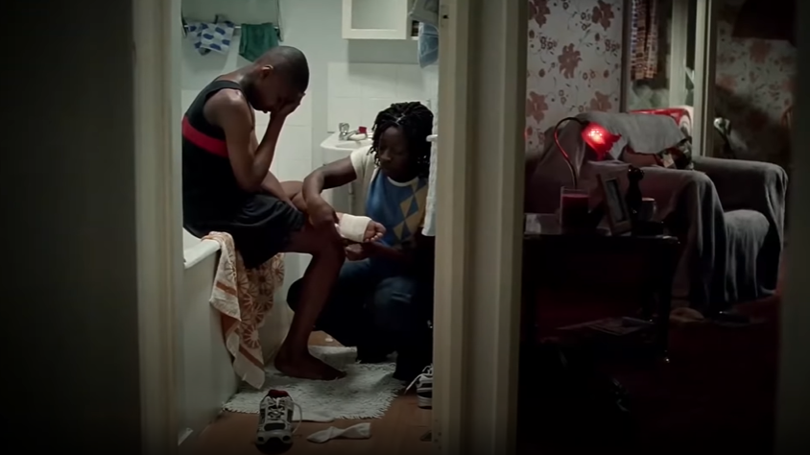
Intended Message 2
Mothers will always be there to support their children and their endeavors
Notes:
A mother will be there with you, throughout your toughest times or boring times. The video shows the mother watching her child train as well as the mother bandaging her child injured foot.

Slide 13
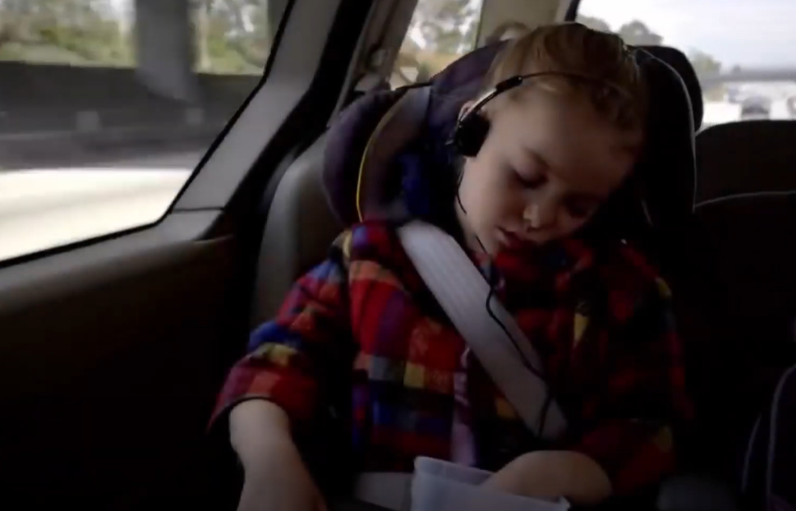
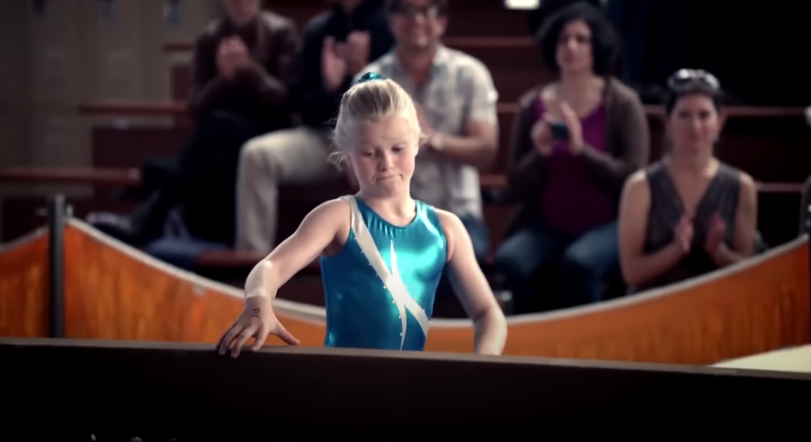
Intended Message 3
It takes a lot of hard work and dedication to achieve success
Notes:
The video shows us that they're so tired that they fell asleep in the car as well as the girl trying over and over again even though she is frustrated that she keeps falling off the balancing beam this shows the perseverance of them

Slide 14

Messaging techniques

Slide 15
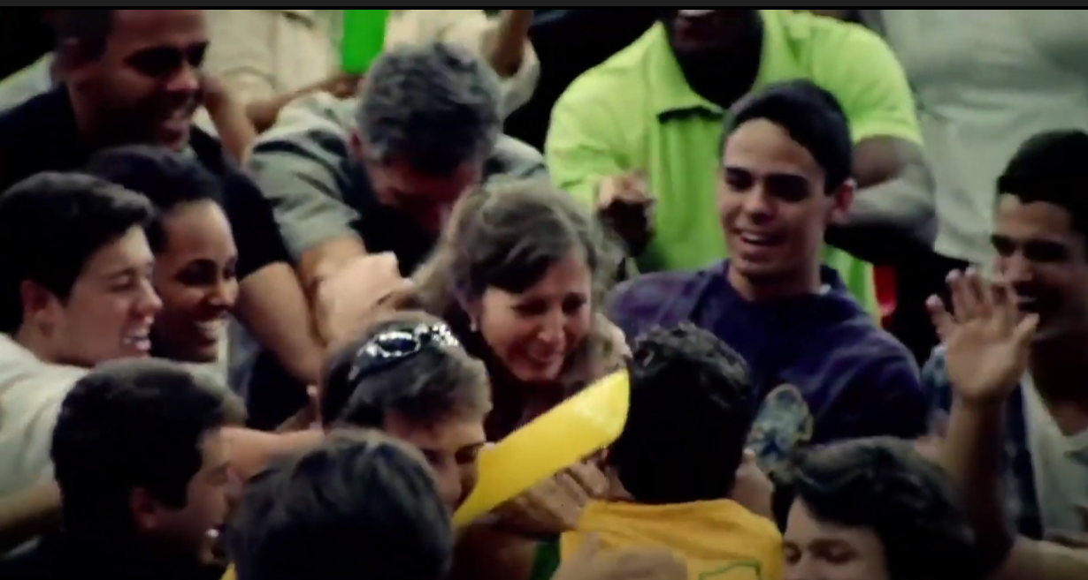

Emotional Appeal
Optimism
Compassion
Notes:
The video shows us that they're so tired that they fell asleep in the car as well as the girl trying over and over again even though she is frustrated that she keeps falling off the balancing beam this shows the perseverance of them

Slide 16
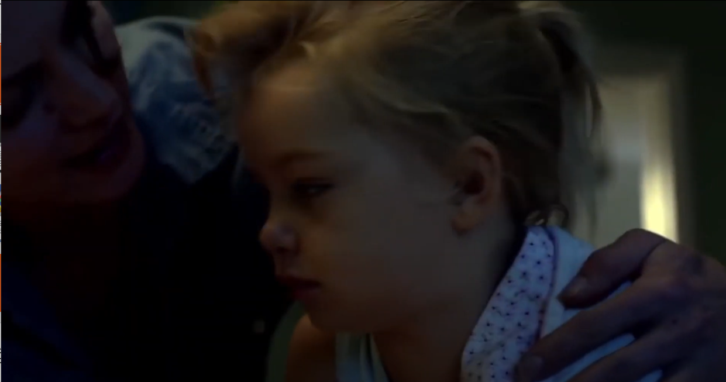
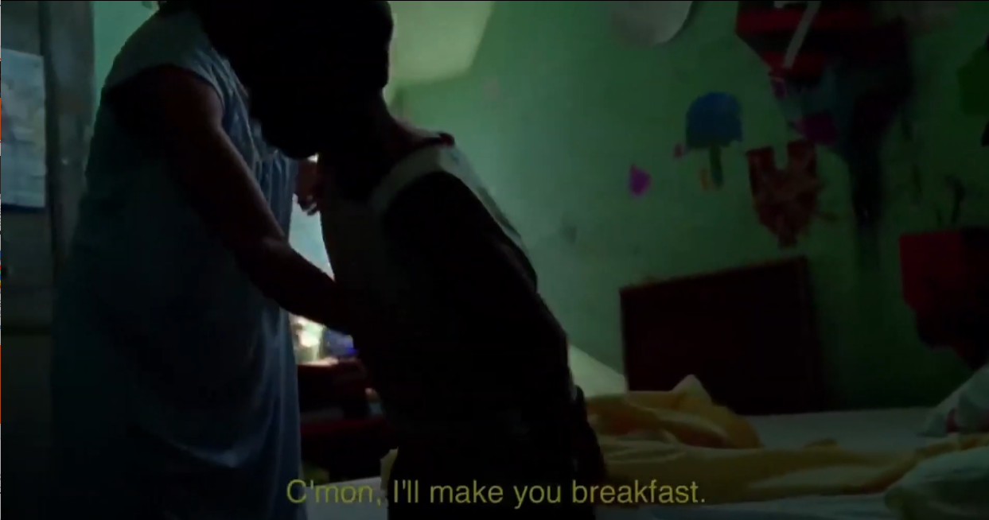
Association
Unconditional love mothers show
Notes:
The video shows us that they're so tired that they fell asleep in the car as well as the girl trying over and over again even though she is frustrated that she keeps falling off the balancing beam this shows the perseverance of them

Slide 17
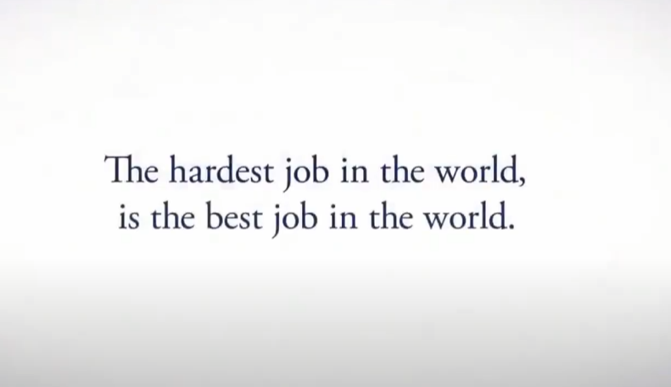


Association
P&G supports mothers
Notes:
The video shows us that they're so tired that they fell asleep in the car as well as the girl trying over and over again even though she is frustrated that she keeps falling off the balancing beam this shows the perseverance of them

Slide 18

Needs & Desires
It appeals to need and desire of love/belonging
Appeals to our needs and desires of lack of prejudice
Notes:
The video shows us that they're so tired that they fell asleep in the car as well as the girl trying over and over again even though she is frustrated that she keeps falling off the balancing beam this shows the perseverance of them

Slide 19
QNA
Thank You
Notes:
The video shows us that they're so tired that they fell asleep in the car as well as the girl trying over and over again even though she is frustrated that she keeps falling off the balancing beam this shows the perseverance of them

